Slide 1
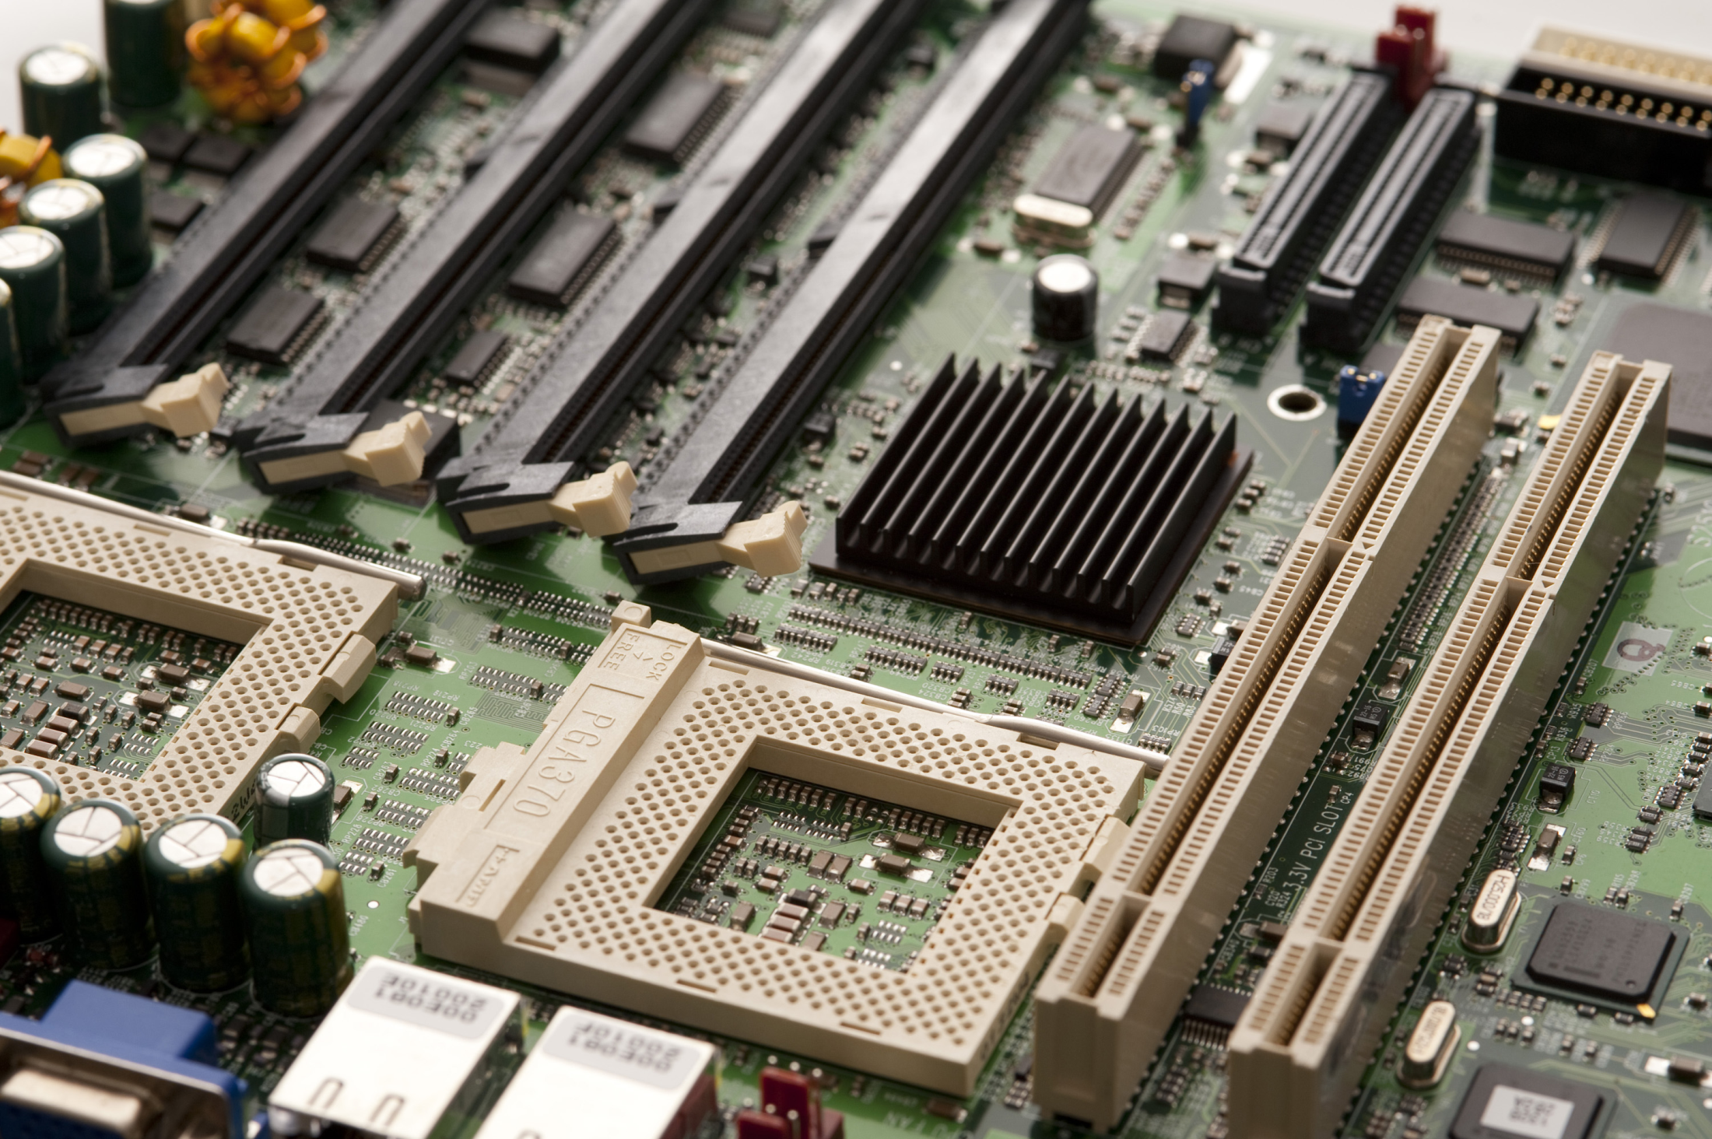
Cx1106
Computer Organization and Architecture
Parallelism - Questions

Slide 2
Which of the following statement(s) are false for processor pipeline?
Pipeline allows different stages of different instructions to be executed in parallel
Pipeline requires independent resources to operate each of the pipeline stages to yield good efficiency
Pipeline allows different stages of the same instruction to be executed in parallel
Pipeline’s efficiency is maximised if there are minimum conflicts during execution
Pipeline split an instruction in different parts and execute them sequentially, different stages of the *same* instruction are not executed in parallel.
Instead, different stages of adjacent instructions are executed in parallel.

Slide 3
**Insufficient resources to execute each of the pipeline stages will lead to
Decrease in pipeline efficiency
Resource conflicts
Increase in pipeline efficiency
Slower processor speed
In order to execute all 4 stages of a pipeline simultaneously, the processor needs to have sufficient resource to handle the 4 stages at the same time.
If any of the resources is not available, that means one or more stages’ execution will be delayed, which in turn affect other stages.
This decreased the overall efficiency of instruction execution in the pipeline concerned.
D: processor (CPU)’s speed is constant-always 1 operation/clock-cycle.

Slide 4
What is the effect of data dependency conflict?
Data dependencies is a phenomenon where the current instructions use an operand whose result hasn’t been updated on time for the execution of the current instruction. This will cause the execution to give a wrong result.
For example, in a 4-stage pipeline consisting of FDES, with the instruction execution at E and result storing at S, data dependency will occur if the operand of current instruction is the destination of the previous instruction. Note again, this relationship depends on the pipeline architecture.
Data in one register is corrupted by data in another register
Data in register/memory is not updated in time for its usage.
Incorrect results obtained from executing affected instructions
Data in register gets modified half way through instruction execution

Slide 5
Which statement below is FALSE?
Delayed branching utilizes delay slots to execute code.
In CPU that supports delayed branching, instructions in delayed slots are not flushed away.
There are no restrictions to the type of instructions that can be inserted in the delay slot.
The delay slot instruction is executed after the branch decision has been made.
[A],[B]. When delay branching is enabled, the delay slots instructions will not be flushed away but will be executed to completion.
[C] There are a few requirement that an instruction needs to meet before it can be placed in the delay slots. Check the lecture slides for details.
[D] When Delay slot instructions are in their E stage, the Branch instruction would already pass its E stage where it made the decision on whether to do the branch or not. This will apply to the case of branch instruction making the decision at D stage as well (e.g., cases with an additional adder; see lecture slides; the branch decision can be done at D stage so there will only be one delay slot in such cases).

Slide 6
What should the programmer do if he can’t find sufficient instructions to be placed in the delay slots?
Patch with NOP instructions
Do nothing and let the processor hardware handle it
Patch with same instruction used in the other delay slot
Patch with the same Branch Instruction
Delay slot instructions will always be executed when delayed branching is enabled, regardless whether the branch is TRUE or FALSE.
For a 4-stage pipeline with branch decision at E stage, the user or compiler needs to arrange/change the instructions such that the two instructions after the branch instruction will be placed in the delay slots.
As such, the sequence of instructions executed in [B], [C], [D] will be different from the original code.

Slide 7
Will the delay slot instructions be able to influence the branch decision?
Yes
No
Depend on the instructions placed in the delay slots
When Delay slot instructions are in their E stage, the Branch instruction would already pass its E stage where it made the decision on whether to do the branch or not. This will apply to the case of branch instruction making the decision at D stage as well.

Slide 8
In Dynamic branch prediction, how would the processor behave if it predicts that the branch would be taken?
Flush the pipeline early to prepare for the jump instruction
Load the instruction at the jump target instead of the next instruction in the code
Load instructions into the delay slots
Discard the instructions after the branch
In dynamic branch prediction, the CPU will fetch the instruction which it think will be the next instruction required.
So if it predicts the branch will be TRUE, the instruction at the branch label will be fetched.
If it predicts the branch will be FALSE, it’ll fetch the next instruction after the branch instruction.

